Slide 1
PROBLEM STATEMENT
DASHBOARD 1: SUMMARY
Good Loan v Bad Loan KPI’s
Good Loan:
Good Loan Application Percentage
Good Loan Applications
Good Loan Funded Amount
Good Loan Total Received Amount
Bad Loan
Bad Loan Application Percentage
Bad Loan Applications
Bad Loan Funded Amount
Bad Loan Total Received Amount
Loan Status Grid View
In order to gain a comprehensive overview of our lending operations and monitor the performance of loans, we aim to create a grid view report categorized by 'Loan Status.’ By providing insights into metrics such as 'Total Loan Applications,' 'Total Funded Amount,' 'Total Amount Received,' 'Month-to-Date (MTD) Funded Amount,' 'MTD Amount Received,' 'Average Interest Rate,' and 'Average Debt-to-Income Ratio (DTI),' this grid view will empower us to make data-driven decisions and assess the health of our loan portfolio.

Slide 2
PROBLEM STATEMENT
DASHBOARD 2: OVERVIEW
CHARTS
Monthly Trends by Issue Date (Line Chart): To identify seasonality and long-term trends in lending activities
Regional Analysis by State (Filled Map): To identify regions with significant lending activity and assess regional disparities
Loan Term Analysis (Donut Chart): To allow the client to understand the distribution of loans across various term lengths.
Employee Length Analysis (Bar Chart): How lending metrics are distributed among borrowers with different employment lengths, helping us assess the impact of employment history on loan applications.
Loan Purpose Breakdown (Bar Chart): Will provide a visual breakdown of loan metrics based on the stated purposes of loans, aiding in the understanding of the primary reasons borrowers seek financing.
Home Ownership Analysis (Tree Map): For a hierarchical view of how home ownership impacts loan applications and disbursements.
Metrics to be shown: 'Total Loan Applications,' 'Total Funded Amount,' and 'Total Amount Received'

Slide 3
PROBLEM STATEMENT
DASHBOARD 3: DETAILS
GRID
Need for a comprehensive 'Details Dashboard' that provides a consolidated view of all the essential information within our loan data. This Details Dashboard aims to offer a holistic snapshot of key loan-related metrics and data points, enabling users to access critical information efficiently.
Objective:
The primary objective of the Details Dashboard is to provide a comprehensive and user-friendly interface for accessing vital loan data. It will serve as a one-stop solution for users seeking detailed insights into our loan portfolio, borrower profiles, and loan performance.

Slide 4



MS SQL SERVER

Slide 5

SQL

Slide 6

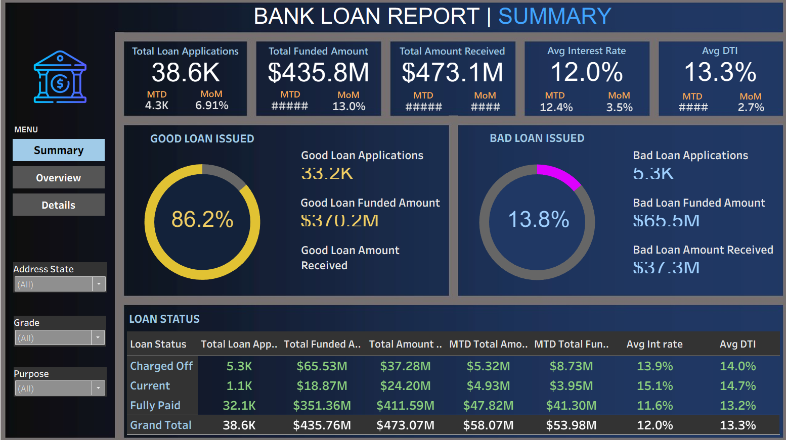
TABLEAU

Slide 7
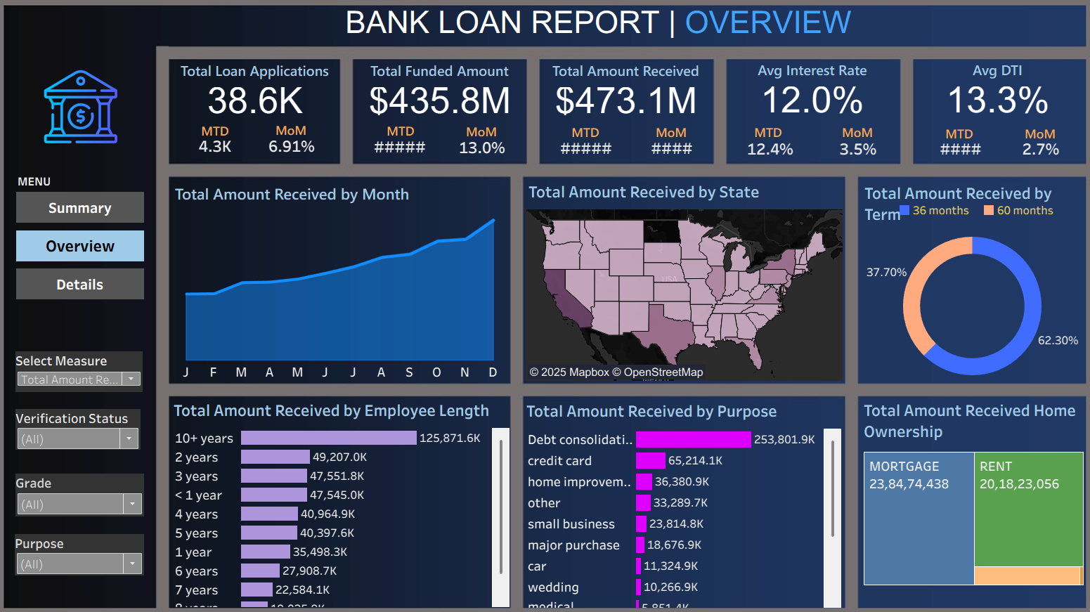
TABLEAU

Slide 8
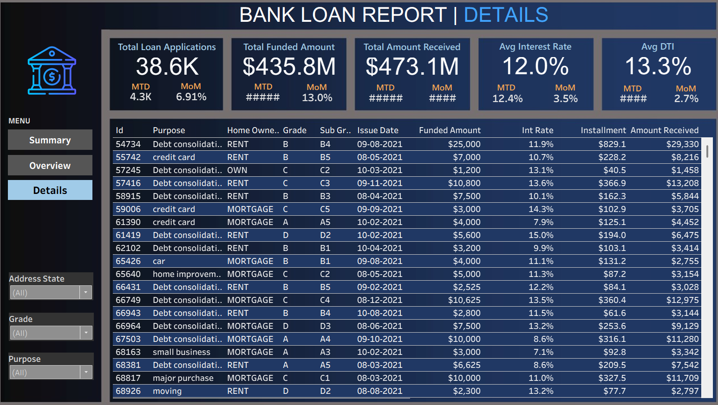
TABLEAU

